Slide 1
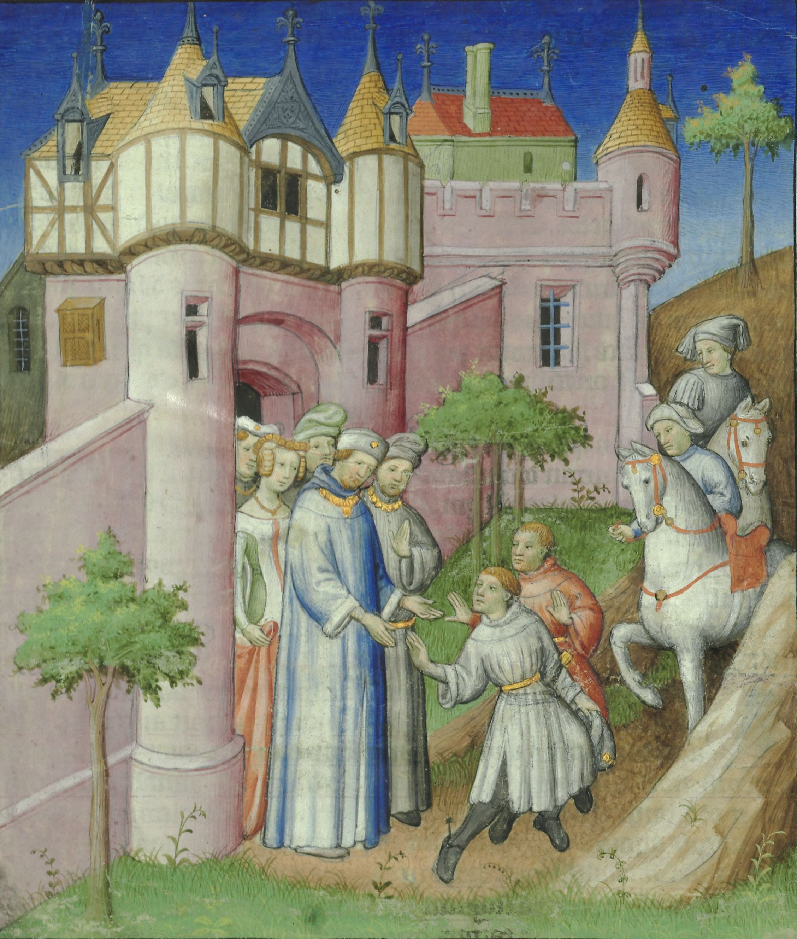
Europeans in Medieval China

Slide 2
The most famous European visitor to China during this period was Marco Polo, preceded, respectively, by his father and uncle Niccol and Maffeo Polo
Given textual and archaeological evidence, it is thought that thousands of Europeans lived in Imperial China during the period of Mongol rule. This occurred primarily during the second half of the 13th century and the first half of the 14th century, coinciding with the rule of the Mongol Empire, which ruled over a large part of Eurasia and connected Europe with their Chinese dominion of the Yuan dynasty (12711368). Whereas the Byzantine Empire centered in Greece and Anatolia maintained rare incidences of correspondence with the Tang, Song and Ming dynasties of China, the Roman papacy sent several missionaries and embassies to the early Mongol Empire as well as to Khanbaliq (modern Beijing), the capital of the Mongol-led Yuan Dynasty. The most famous European visitor to China during this period was Marco Polo, preceded, respectively, by his father and uncle Niccol and Maffeo Polo. The establishment of the Ming dynasty in 1368 and reestablishment of native Han Chinese rule led to the cessation of European merchants and Roman Catholic missionaries living in China.

Slide 3
The Italian merchant Marco Polo, as well as his father and uncle Niccol and Maffeo Polo, respectively, traveled to China during the period of Mongol rule
Direct contact with Europeans was not renewed until Portuguese explorers and Jesuit missionaries arrived on Ming China's southern shores at the beginning of the 16th century, during the Age of Exploration. The Italian merchant Marco Polo, as well as his father and uncle Niccol and Maffeo Polo, respectively, traveled to China during the period of Mongol rule. Marco Polo wrote an account of his travels there, as did the Franciscan friar Odoric of Pordenone, the merchant Francesco Balducci Pegolotti, and the author John Mandeville. In Khanbaliq, the Roman archdiocese was established by John of Montecorvino, who was later succeeded by Giovanni de Marignolli. Other Europeans such as Andr de Longjumeau managed to reach the eastern borderlands of China in their diplomatic travels to the Mongol royal court, while others such as Giovanni da Pian del Carpine, Benedykt Polak, and William of Rubruck traveled instead to Mongolia.

Slide 4
Roman golden medallions from the reigns of Antoninus Pius and his adopted son Marcus Aurelius have been found in Oc Eo (near Ho Chi Minh City), a territory that belonged to the Kingdom of Funan bordering Jiaozhi
However, it is known that other Indo-European peoples such as the Yuezhi, Saka, and Tocharians inhabited the Tarim Basin before and after it was brought under Han Chinese influence during the reign of Emperor Wu of Han (r. 14187 BC). In 166 AD the Book of Later Han records that Romans reached China from the maritime south and presented gifts to the court of Emperor Huan of Han (r. 146168 AD), claiming they represented Roman emperor Marcus Aurelius Antoninus (Andun ) (r. 161180 AD). Roman golden medallions from the reigns of Antoninus Pius and his adopted son Marcus Aurelius have been found in Oc Eo (near Ho Chi Minh City), a territory that belonged to the Kingdom of Funan bordering Jiaozhi. It is possible that a group of Greek acrobatic performers, who claimed to be from a place "west of the seas" (i.e. Roman Egypt, which the Book of Later Han related to the "Daqin" empire), were presented by a king of Burma to Emperor An of Han in 120 AD. From this revelation monks were sent by the Byzantine Emperor Justinian (ruled 527565) as spies on the Silk Road from Constantinople to China and back to steal the silkworm eggs.

Slide 5
During the subsequent Song period there was also a community of Kaifeng Jews in China
During the subsequent Song period there was also a community of Kaifeng Jews in China. Polo, a 13th-century merchant from the Republic of Venice, describes his travels to Yuan-dynasty China and the court of Mongol ruler Kublai Khan, along with the preceding journeys made by Niccol and Maffeo Polo, his father and uncle, respectively, in his Travels of Marco Polo. His claim is confirmed by a Chinese text of the 14th century explaining how a Sogdian named Mar-Sargis from Samarkand founded six Nestorian Christian churches there in addition to one in Hangzhou during the second half of the 13th century. In about 1340 Francesco Balducci Pegolotti, a merchant from Florence, compiled a guide about trade in China, a country he called Cathay, noting the size of Khanbaliq (modern Beijing) and how merchants could exchange silver for Chinese paper money that could be used to buy luxury items such as silk. Marco Polo mentioned the heavy presence of Genoese Italians at Tabriz (modern Iran) a city that Marco returned to from China via the Strait of Hormuz in 12931294.

Slide 6
The Italian Franciscan monk John of Montecorvino took this same journey in reverse starting in 1291, setting out from Tabriz to Ormus, sailing from there to China while accompanied by the Italian merchant Pietro de Lucalongo
The Italian Franciscan monk John of Montecorvino took this same journey in reverse starting in 1291, setting out from Tabriz to Ormus, sailing from there to China while accompanied by the Italian merchant Pietro de Lucalongo. His biography in the History of Yuan lists his children by their Chinese names, which are similar to the Christian names Elias (Ye-li-ah), Luke (Lu-ko), and Antony (An-tun), with a daughter named A-na-si-sz. The Italian explorer and archbishop Giovanni da Pian del Carpine and Polish frair and traveler Benedykt Polak were the first papal envoys to reach Karakorum after being sent there by Pope Innocent IV in 1245. The Franciscan missionary John of Montecorvino (Giovanni da Montecorvino) was ordered to China by Pope Nicholas III in 1279. They were converted to Catholicism by John of Montecorvino.

Slide 7
Toghon Temr (the last Mongol ruler of the Yuan dynasty in China before their retreat to Mongolia to form the Northern Yuan dynasty) sent an embassy including Genoese Italians to Pope Benedict XII in 1336, requesting a new archbishop
Following the death of John of Montecorvino, Giovanni de Marignolli was dispatched to Beijing to become the new archbishop from 1342 to 1346 in an effort to maintain a Christian influence in the region. The Franciscan Friar Odoric of Pordenone visited China. In 1333, John de Montecorvino was officially replaced by Nicolaus de Bentra, who was chosen by Pope John XXII. Toghon Temr (the last Mongol ruler of the Yuan dynasty in China before their retreat to Mongolia to form the Northern Yuan dynasty) sent an embassy including Genoese Italians to Pope Benedict XII in 1336, requesting a new archbishop. In 1370, following the ousting of the Mongols from China and the establishment of the Chinese Ming dynasty, the Pope sent a new mission to China, comprising the Parisian theologian Guillaume du Pr as the new archbishop and 50 Franciscans.

